Slide 1

Helping new
talent into
the tech world

Slide 2
Agenda
Short intro & update (16:00)
Election of moderator
Election of reporter
Registration of attendees
Election of vote counter
Discussion (16:20)

Slide 3
Agenda
Election of chairperson (17:00)
Election of vice-chairperson
Election of Treasurer
Election of Mentor Representative
Election of Student Representative
Other (17:20)

Slide 4
Agenda
Short intro & update (16:00)
Election of moderator
Election of reporter
Registration of attendees
Election of vote counter
Discussion (16:20)

Slide 5
Discussion

Slide 6
Results 2020

Slide 7
Goals 2020
 | Goal | Result
Amount fo classes start | 3-4 | 4
Amount of students start | 45-60 | 64
Graduated students | 40 | 46
Share of female students | 50% | 60.94%
In employment | 25 | 31

Slide 8
Goals 2021

Slide 9
Goals 2021
 | 2021
Amount fo classes start | 3-4
Amount of students start | 45-60
Graduated students | 40
Share of female students | 50%
In employment | 25

Slide 10
Results visualisation (entire project period)

Slide 11
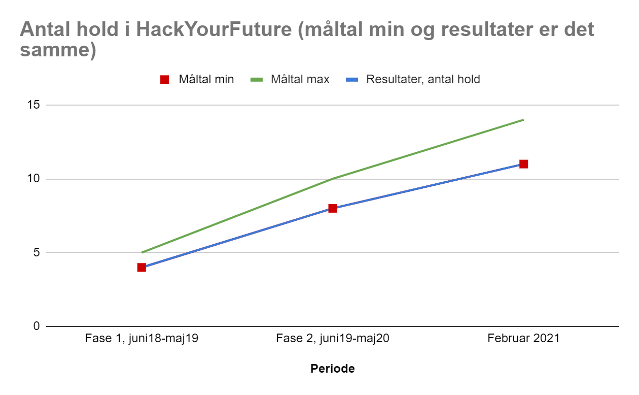

Slide 12
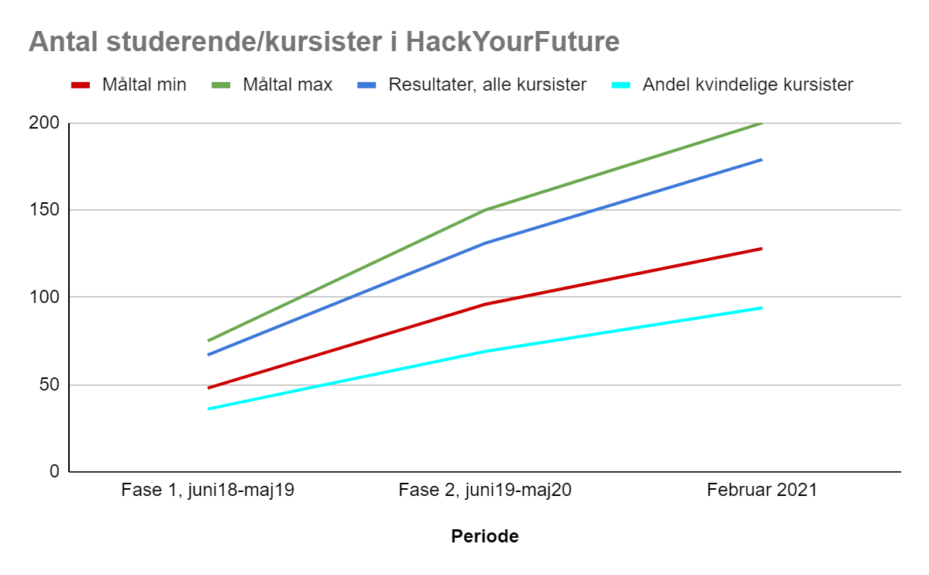

Slide 13
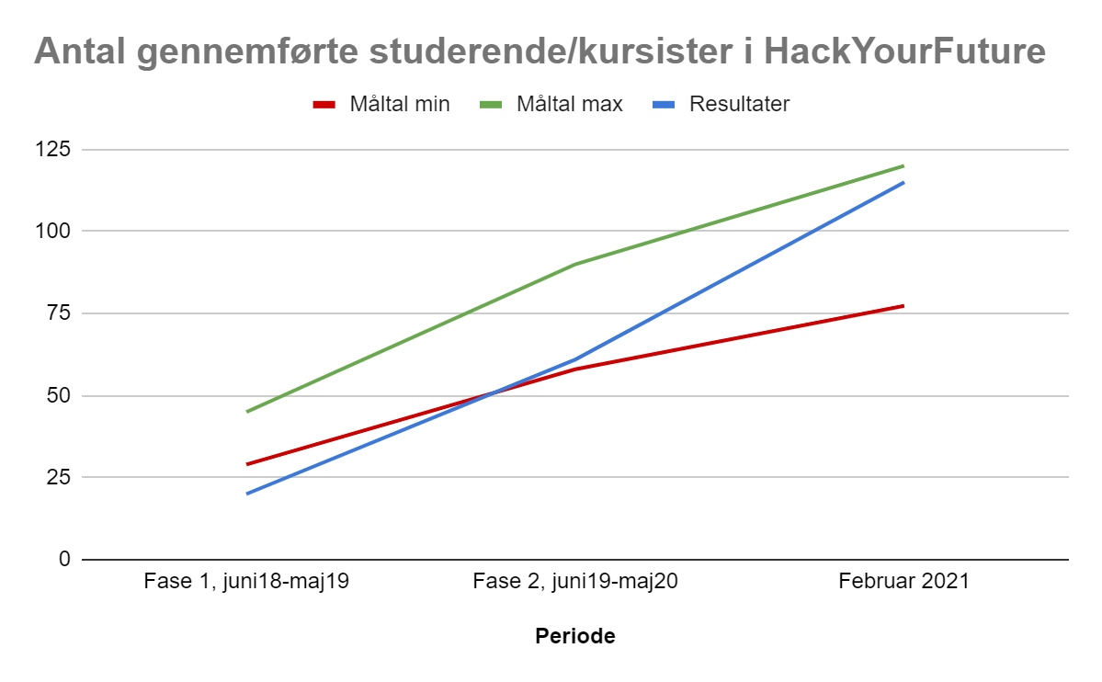

Slide 14
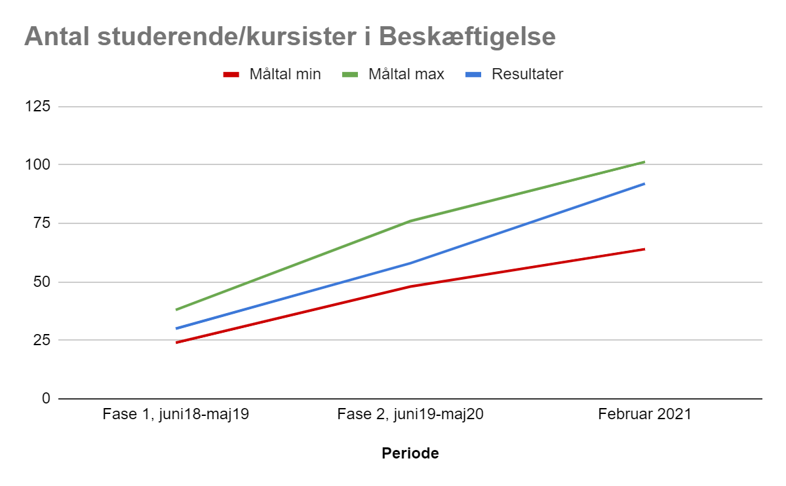

Slide 15
Annual financial statement 2020

Slide 16
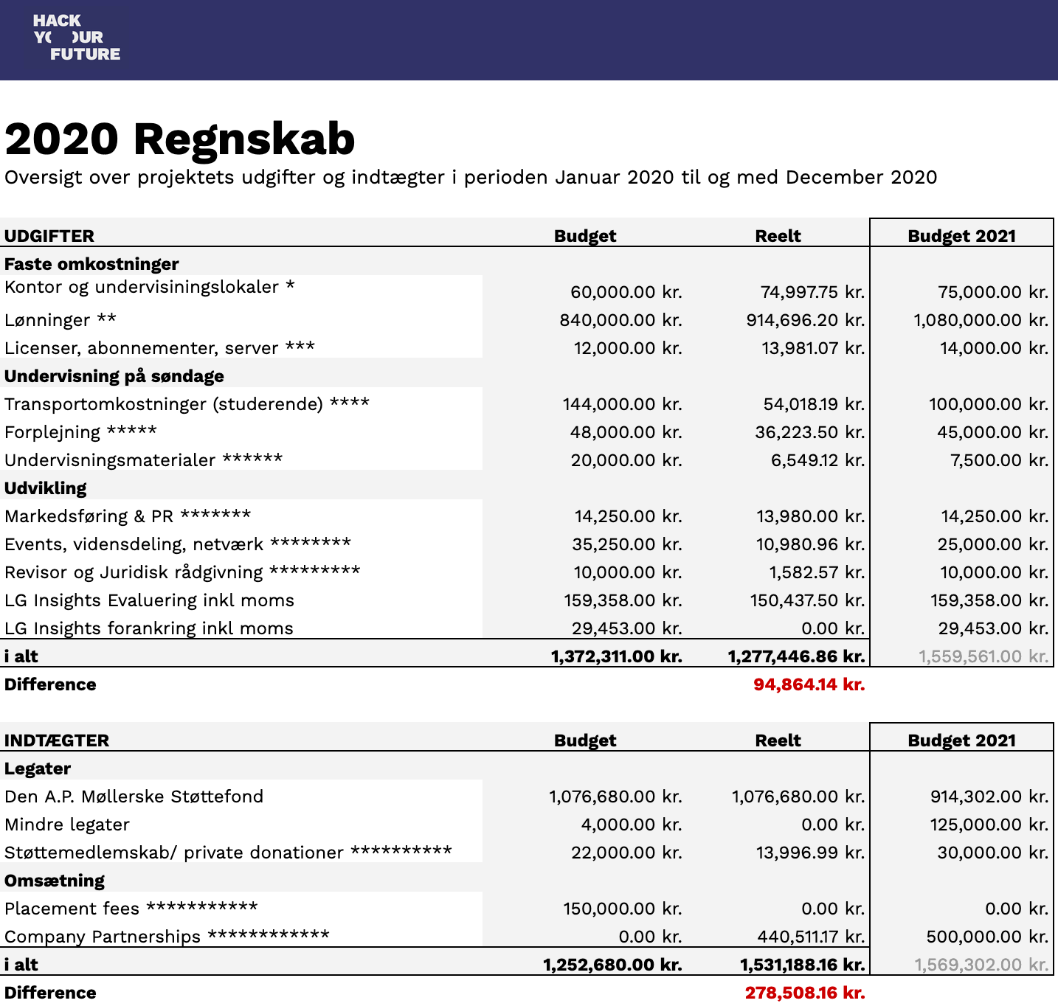

Slide 17
Vision, Mission & Values

Slide 18
Changes to statutes

Slide 19
Explorative Project:
HYF Aarhus

Slide 20

Helping new
talent into the Aarhus tech world

Slide 21














Tech ecosystem looks good:
https://docs.google.com/spreadsheets/d/1zCKB6pJ4drV-26Y-Tqr4QXOMhl_CRMhnl9MNfr1Htw0/edit#gid=0
Notes:
https://docs.google.com/spreadsheets/d/1zCKB6pJ4drV-26Y-Tqr4QXOMhl_CRMhnl9MNfr1Htw0/edit#gid=0

Slide 22
Agenda
Election of chairperson (17:00)
Election of vice-chairperson
Election of Treasurer
Election of Mentor Representative
Election of Student Representative
Other (17:20)

